Slide 1
thanks to
≈?
because of, as a result of, owing to, due to,
on account of, resulting from

Slide 2
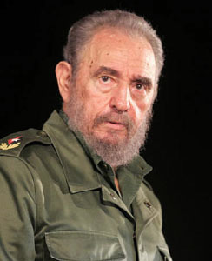
thanks to
He had great sympathy for the poor,
so he spent most of his time and
energy fighting for their legal rights.
Castro
Thanks to his great sympathy for the poor,
he spent most of his time and energy fighting for their legal rights.

Slide 3
thanks to
He was very determined, so at last
freed his country from dependence
on the US and help Cubans
rediscover their national identity
and their pride.
Castro
Thanks to his great determination, he at last
freed his country from dependence on the US
and help Cubans rediscover their national
identity and their pride.

